Slide 1

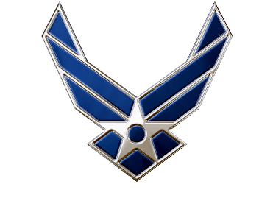

Week 13 PT
C/Lt Col Vallor and C/2d Lt Al Luhaibat
Air Force ROTC Detachment 842
The University of Texas at San Antonio

Slide 2


Overview
Tuesday PT
Thursday PT
Air Force ROTC Detachment 842 • We Build Exceptional Officers • The University of Texas at San Antonio

Slide 3
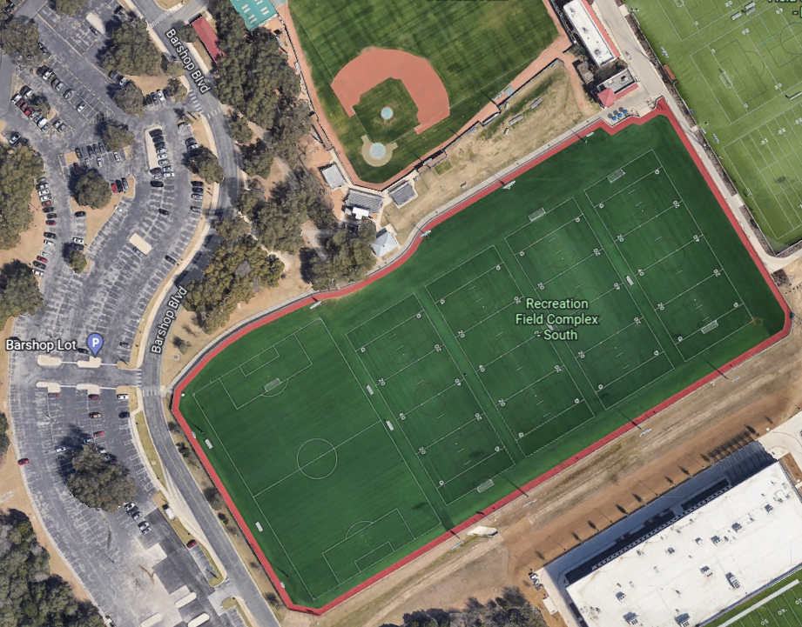
Tuesday PT
ONLY KEY ROLES WILL PRACTICE at Soccer Field
Flight Commanders
Deputy Flight Commanders
Guidon Bearers
Guides
Command Staff
Everyone else will hold normal PT
Normal PT
Pass and Review
Air Force ROTC Detachment 842 • We Build Exceptional Officers • The University of Texas at San Antonio

Slide 4
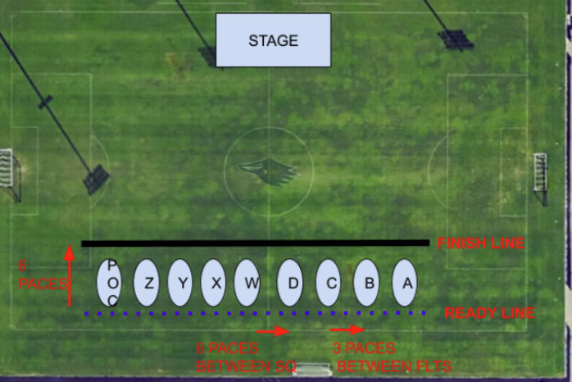
Thursday PT
Entire WING will practice
Form up based on Figure 1
Rec Field 4
Figure 1
Air Force ROTC Detachment 842 • We Build Exceptional Officers • The University of Texas at San Antonio

Slide 5
Summary
Tuesday PT
Thursday PT
Air Force ROTC Detachment 842 • We Build Exceptional Officers • The University of Texas at San Antonio

Slide 6
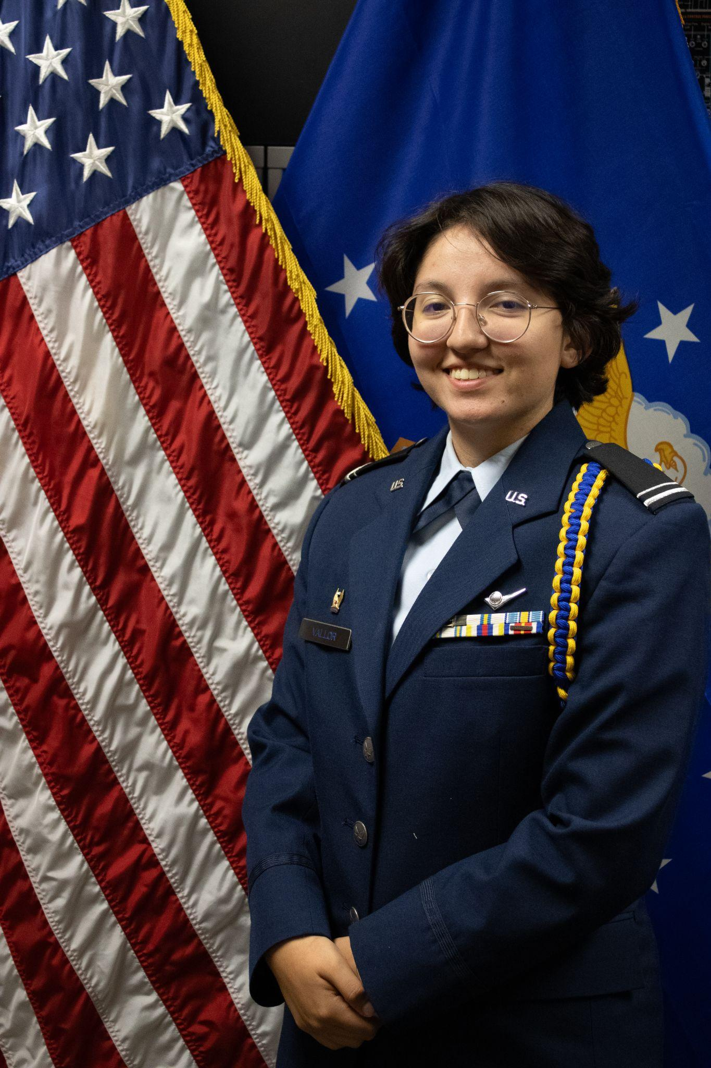
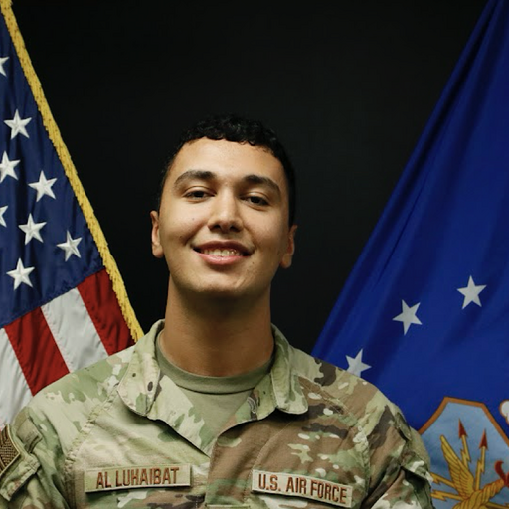
Questions?
C/Lt Col Vallor
Deputy Commander of Operations
mary.vallor@my.utsa.edu
210.913.5497
C/2d Lt Al Luhaibat
LLAB Execution Officer
taha.alluhaibat@my.utsa.edu
830.765.7359
Air Force ROTC Detachment 842 • We Build Exceptional Officers • The University of Texas at San Antonio

